Slide 1


SMART BLIND GLASSES
Prepared By:-
VEDANT SIMARIA
Roll no:236
Batch:6A Branch: CE

Slide 2
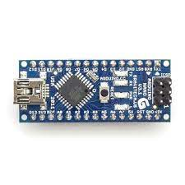
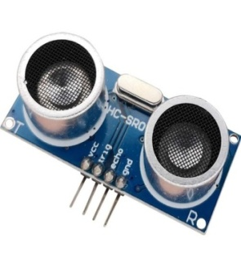
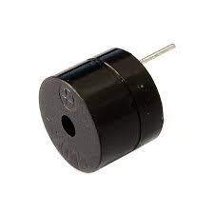
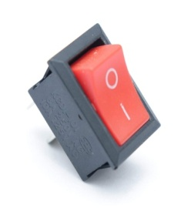
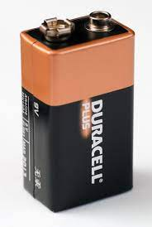
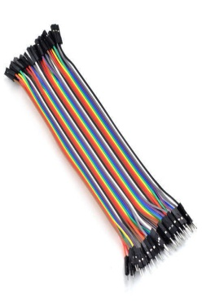
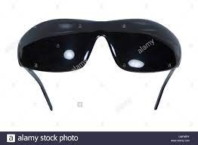
MATERIALS REQUIRED :-
Buzzer
Ultrasonic Sensor
Switch
Arduino Nano
Blind Glasses
Jumper Wires
Battery

Slide 3

Arduino Nano | Ultrasonic Sensor
The Arduino Nano is a small Arduino board based on ATmega328P or ATmega628 Microcontroller. | An ultrasonic sensor is an electronic device that measures the distance of a target object by emitting ultrasonic sound waves, and converts the reflected sound into an electrical signal.
It is small in size compared to the UNO board. | When triggered, the ultrasonic sensor generates eight acoustic(ultrasonic) wave burst and initiates a time counter.
The Nano board is defined as a sustainable, small, consistent microcontroller board. | The output of the ultrasonic sensor is a high pulse with the same duration as the time difference between transmitted and the received signal.

Slide 4
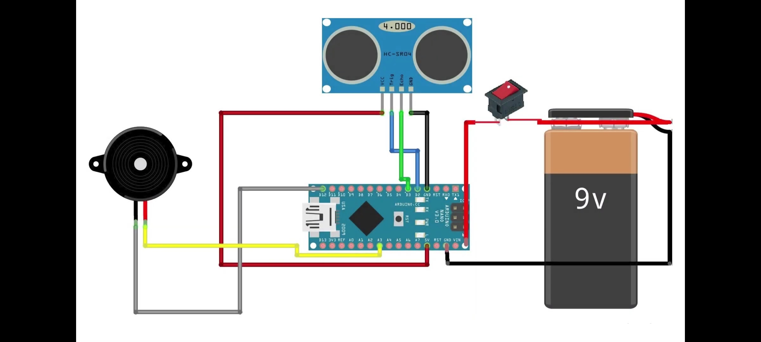
CIRCUIT DIAGRAM

Slide 5
APPLICATIONS OF ULTRASONIC SENSOR
It uses to avoid and detect obstacles with robots like obstacle avoider robot, pathfinding robot etc.
Used to measure the distance within a wide range of 2cm to 400cm.
Depth of certain places like wells, pits, etc can be measured since the waves can penetrate through the water.

Slide 6
MERITS and DEMERITS
Merits | Demerits
It is used to guide the user(blind) to reach to the respective destination by avoiding collisions. | They cannot detect obstructions that are hidden but very dangerous for the blind such as downward stairs, holes etc.
The advantage of our project is that it can detect any obstacle with the help of ultrasonic sensors and can provide a precise location of obstacle in front of the blind person. | Because these systems communicate their recommendations to the user through sound or vibrations, the blind people will require a proper training to understand and to react to them in real time, in which TRAINING is MORE EXPENSIVE than product itself.

Slide 7
THANK YOU….

